Slide 1

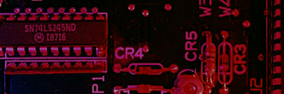
Summary
Counters

Slide 2
Summary
A Counter is a device which stores (and sometimes displays) the number of times a particular event or process has occurred
Counters are used in digital electronics for counting purpose, they can count specific event happening in the circuit

Slide 3
Summary
Counters are sequential circuit that count the number of pulses can be either in binary code or BCD form.
The main properties of a counter are timing , sequencing , and counting. Counter works in two modes.
Up counter
Down counter

Slide 4
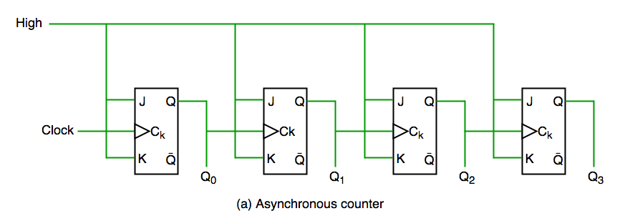
Summary
Counter Classification
Counters are broadly divided into two categories
Asynchronous counter
In asynchronous counter we don’t use universal clock, only first flip flop is driven by main clock and the clock input of rest of the following flip flop is driven by output of previous flip flops. We can understand it by following diagram-
S
Q
Q
R

Slide 5
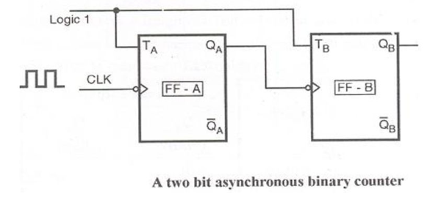
Summary
Counter Classification
2- bit Asynchronous counter Up counter (Ripple Counter )

Slide 6
Summary
Counter Classification
It is evident from timing diagram that Q0 is changing as soon as the rising edge of clock pulse is encountered, Q1 is changing when rising edge of Q0 is encountered(because Q0 is like clock pulse for second flip flop) and so on.
In this way ripples are generated through Q0,Q1,Q2,Q3 hence it is also called RIPPLE counter

Slide 7
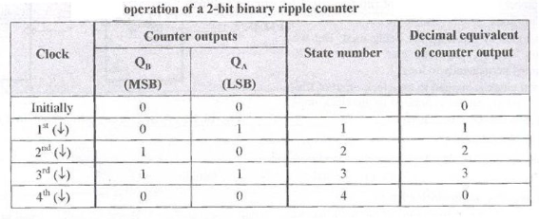
Summary
Counter Classification
2- bit Asynchronous counter Up counter (Ripple Counter )

Slide 8
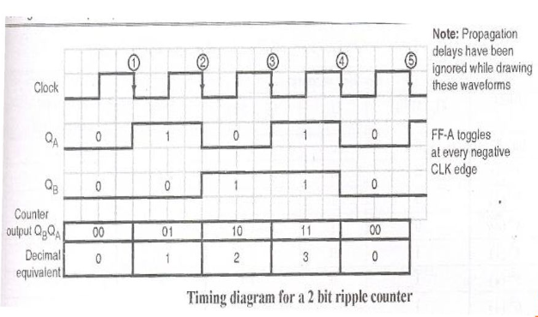
Summary
Counter Classification
2- bit Asynchronous counter Up counter (Ripple Counter )

Slide 9
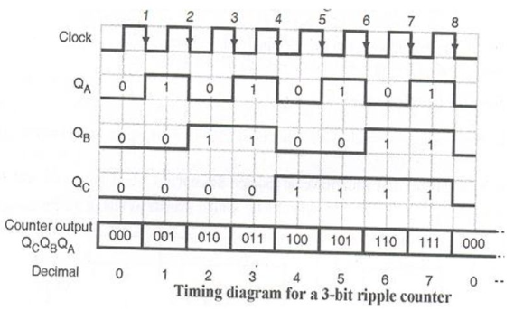
Summary
Counter Classification
3- bit Asynchronous counter Up counter (Ripple Counter )

Slide 10
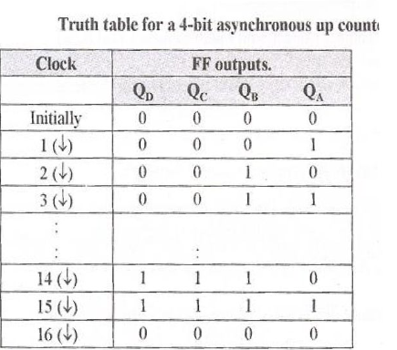
Summary
Counter Classification
4- bit Asynchronous counter Up counter (Ripple Counter )

Slide 11
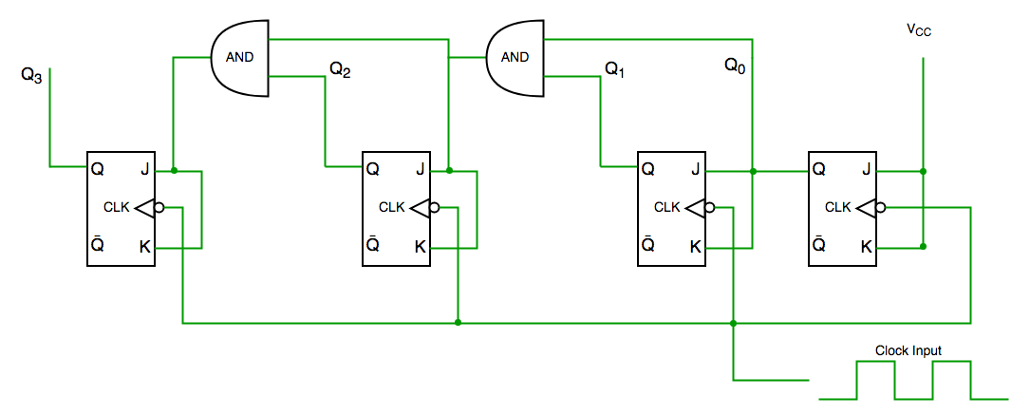
Summary
Counter Classification
Counters are broadly divided into two categories
2. Synchronous Counter
synchronous counter has one global clock which drives each flip flop so output changes in parallel. The one advantage of synchronous counter over asynchronous counter is, it can operate on higher frequency than asynchronous counter as it does not have cumulative delay because of same clock is given to each flip flop.
S
Q
Q
R

Slide 12
Summary
Counter Classification
Clock pulse | Q3 | Q2 | Q1 | Q0
0 | 0 | 0 | 0 | 0
1 | 0 | 0 | 0 | 1
2 | 0 | 0 | 1 | 0
3 | 0 | 0 | 1 | 1
4 | 0 | 1 | 0 | 0
5 | 0 | 1 | 0 | 1
6 | 0 | 1 | 1 | 0
7 | 0 | 1 | 1 | 1
8 | 1 | 0 | 0 | 0
9 | 1 | 0 | 0 | 1
Decade Counter
A decade counter counts ten different states and then reset to its initial states.
A simple decade counter will count from 0 to 9 but we can also make the decade counters which can go through any ten states between 0 to 15 (for 4 bit counter).

Slide 13
Summary
Counter Classification
Modulus Counters, or simply MOD counters, are defined based on the number of states that the counter will sequence through before returning back to its original value.
For example, a 2-bit counter that counts from 00₂ to 11₂ in binary, that is 0 to 3 in decimal, has a modulus value of 4 ( 00 → 1 → 10 → 11, and return back to 00 ) so would therefore be called a modulo-4, or mod-4, counter. Note also that it has taken four clock pulses to get from 00 to 11.
Mod 1 Mod 2 Mod 3 Mod 4 Mod 5
0 1 2 3 4

Slide 14
Summary
Cascaded Counters
Counters can be connected in cascade to achieve higher – modules operation.
In essence, cascading means that the last stage output of one counter drives the input of the next counter.

Slide 15
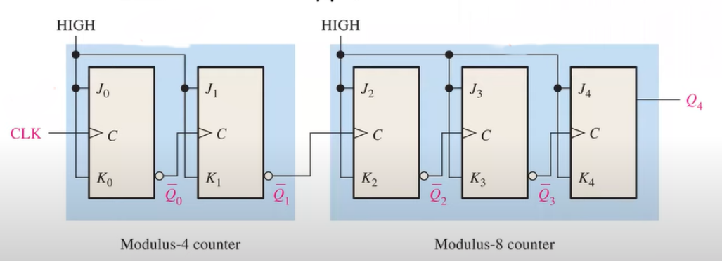
Summary
Asynchronous Cascaded
An example of two asynchronous counters connected in cascade in shown.
Two cascaded asynchronous counters (all J and K input are HIGH).

Slide 16
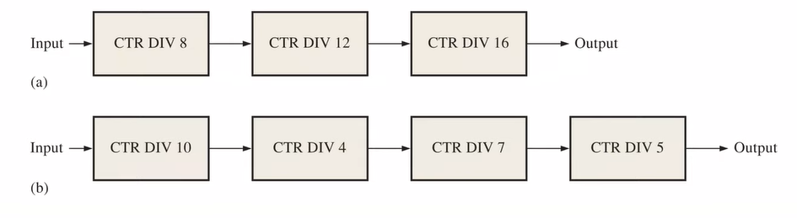
Summary
Asynchronous Cascaded
Determine the overall modulus of the two cascaded counters configuration .
The over all modules for the 3*counter configuration is
8x 12 x 16 = 1536
The overall modules for the 4 counters configuration is
10 x 4 x 7 x 5 x =1400

